Slide 1
Lab 5 Command Pattern
Please download the corresponding materials

Slide 2
Before introducing the lab, please pay attention to the following issues:
1, sign in the attendance sheet (20% point deduction for absence);
2, the due (02/28/2018);
3, demo: any labs or office hours before the deadline (redemo is okay); our next lab (03/01/2018) (redemo is not allowed)
4, office hour: Monday 1:00 – 2:00 P.M Tuesday 3:00 – 4:00 P.M
5, submission: push code on Github repo, screenshot of your Github on iLearn
6, introduce: Command Pattern, implement based on Composite Pattern (you can use starter code in Github repository)

Slide 3
Overview
Implement a calculator with several functions
Example
Calculate
Undo
Redo
Exit

Slide 4
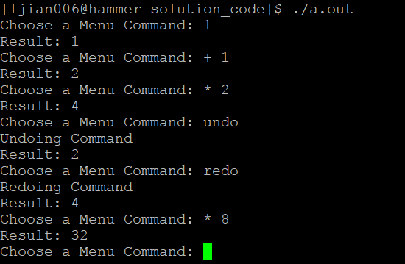
Overview
Simplified Demo

Slide 5
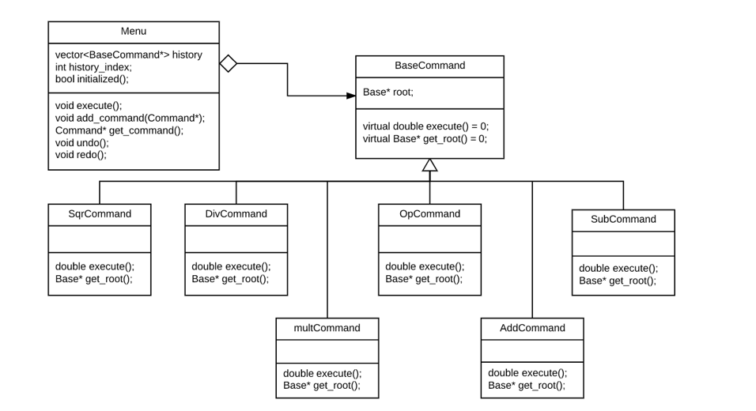
Command Classes

Slide 6
Command Classes
Implement constructor functions for all child classes of BaseCommand ( implement functions in “command.h” )
AddCommand, SubCommand, MultCommand
Two input parameters: Command*, double value
Create a base tree for double value – right tree
Use get_root() to get base tree for Command –left tree
Call constructor function of Add, Sub, Multi classes to generate new root of tree
Notes:
Command* represents current command

Slide 7
Command Classes
3. SqrCommand
One input parameter: Command*
Use get_root() to get base tree for Command –left tree
Call constructor function of Sqr to generate new root of tree
OpCommand
One input parameter: double value
Call constructor function of Op to generate new root of tree
Notes:
Command* represents current command

Slide 8
Menu Class
Perform several functions: e.g add command, calculation, undo, redo etc
Important data structure:
vector<Command*> history; //save many commands
int history_index; //point to current command in history
Initial value for history_index can be either 0 or -1
Implement “menu.h”

Slide 9
Menu Class
Example
Sequence: 1 -> * 2 -> + 5 -> undo -> undo -> undo -> undo -> redo -> +2 -> redo -> redo
Initial:
Vector:
history_index:

Slide 10
Menu Class
Example
Sequence: 1 -> * 2 -> + 5 -> undo -> undo -> undo -> undo -> redo -> +2 -> redo -> redo
Current: 1
Vector:
history_index:
 | 1

Slide 11
Menu Class
Example
Sequence: 1 -> * 2 -> + 5 -> undo -> undo -> undo -> undo -> redo -> +2 -> redo -> redo
Current: * 2
Vector:
history_index:
 | 1 | 1*2

Slide 12
Menu Class
Example
Sequence: 1 -> * 2 -> + 5 -> undo -> undo -> undo -> undo -> redo -> +2 -> redo -> redo
Current: + 5
Vector:
history_index:
 | 1 | 1*2 | 1*2+5

Slide 13
Menu Class
Example
Sequence: 1 -> * 2 -> + 5 -> undo -> undo -> undo -> undo -> redo -> +2 -> redo -> redo
Current: undo
Vector:
history_index:
 | 1 | 1*2 | 1*2+5

Slide 14
Menu Class
Example
Sequence: 1 -> * 2 -> + 5 -> undo -> undo -> undo -> undo -> redo -> +2 -> redo -> redo
Current: undo
Vector:
history_index:
 | 1 | 1*2 | 1*2+5

Slide 15
Menu Class
Example
Sequence: 1 -> * 2 -> + 5 -> undo -> undo -> undo -> undo -> redo -> +2 -> redo -> redo
Current: undo
Vector:
history_index:
 | 1 | 1*2 | 1*2+5

Slide 16
Menu Class
Example
Sequence: 1 -> * 2 -> + 5 -> undo -> undo -> undo -> undo -> redo -> +2 -> redo -> redo
Current: undo
Vector:
history_index:
 | 1 | 1*2 | 1*2+5

Slide 17
Menu Class
Example
Sequence: 1 -> * 2 -> + 5 -> undo -> undo -> undo -> undo -> redo -> +2 -> redo -> redo
Current: redo
Vector:
history_index:
 | 1 | 1*2 | 1*2+5

Slide 18
Menu Class
Example
Sequence: 1 -> * 2 -> + 5 -> undo -> undo -> undo -> undo -> redo -> +2 -> redo -> redo
Current: + 2
Vector:
history_index:
 | 1 | 1+2 | 1*2+5

Slide 19
Menu Class
Example
Sequence: 1 -> * 2 -> + 5 -> undo -> undo -> undo -> undo -> redo -> +2 -> redo -> redo
Current: redo
Vector:
history_index:
 | 1 | 1+2 | 1*2+5

Slide 20
Menu Class
Example
Sequence: 1 -> * 2 -> + 5 -> undo -> undo -> undo -> undo -> redo -> +2 -> redo -> redo
Current: redo
Vector:
history_index:
 | 1 | 1+2 | 1*2+5

Slide 21
Notice
Since there are starter codes in your Github repository, you only need to implement “menu.h” and “command.h”
Pay more attention to bounding conditions in your implementation
Please test all types of commands mentioned in lab description before submission and demo

